Slide 1

Webdriver Vs Selenium RC

Slide 2
Introduction
Before the advent of WebDriver in 2006, there was another, automation tool called Selenium Remote Control. Both WebDriver and Selenium RC have following features:
They both allow you to use a programming language in designing your test scripts.
They both allow you to run your tests against different browsers.

Slide 3
Architecture of Selenium RC
Selenium RC's architecture is way more complicated.
You first need to launch a separate application called Selenium Remote Control (RC) Server before you can start testing
The Selenium RC Server acts as a "middleman" between your Selenium commands and your browser
When you begin testing, Selenium RC Server "injects" a Javascript program called Selenium Core into the browser.
Once injected, Selenium Core will start receiving instructions relayed by the RC Server from your test program.
When the instructions are received, Selenium Core will execute them as Javascript commands.
The browser will obey the instructions of Selenium Core and will relay its response to the RC Server.
The RC Server will receive the response of the browser and then display the results to you.
RC Server will fetch the next instruction from your test script to repeat the whole cycle.

Slide 4
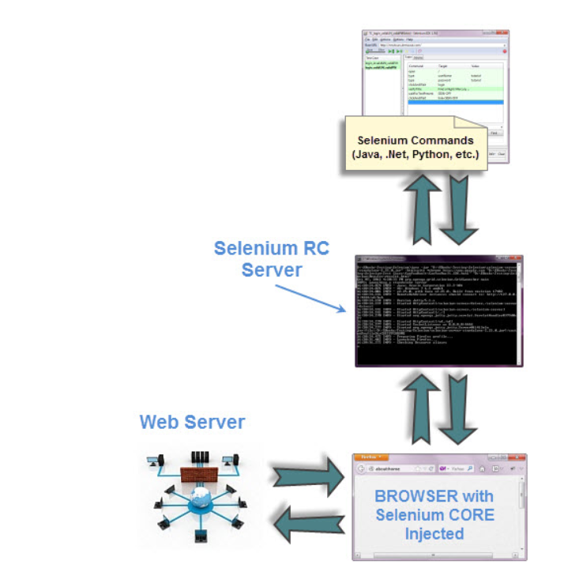
Architecture-2

Slide 5
Speed
WebDriver is faster than Selenium RC since it speaks directly to the browser uses the browser's own engine to control it.
Selenium RC is slower since it uses a Javascript program called Selenium Core. This Selenium Core is the one that directly controls the browser, not you.

Slide 6
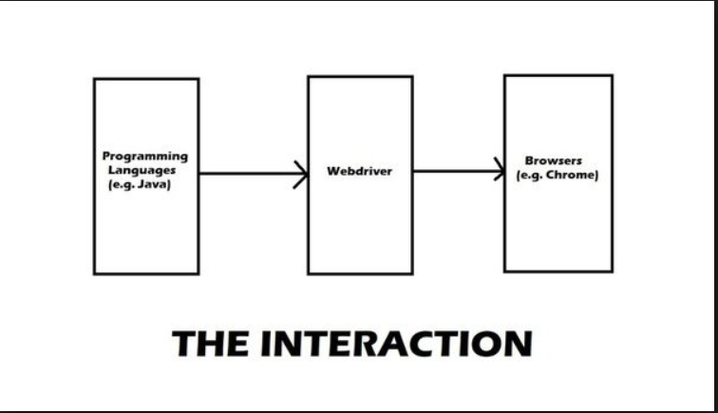
Interaction with Page Elements

Slide 7
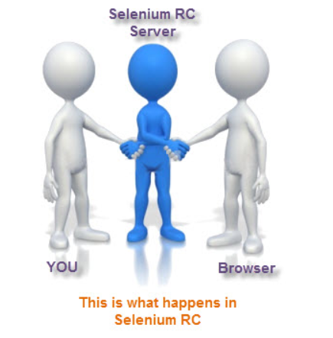
Interaction with Page Elements

Slide 8
Browser Supported
WebDriver can support the headless HtmlUnit browser
Selenium RC cannot support the headless HtmlUnit browser. It needs a real, visible browser to operate on.
WebDriver Cannot Readily Support New Browsers
Remember that WebDriver operates on the OS level. Also, remember that different browsers communicate with the OS in different ways. If a new browser comes out, it may have a different process of communicating with the OS as compared to other browsers. So, you have to give the WebDriver team quite some time to figure that new process out before they can implement it on the next WebDriver release.

Slide 9
Inbuilt Test Result Generator
Selenium RC automatically generates an HTML file of test results. The format of the report was pre-set by RC itself.
WebDriver has no built-in command that automatically generates a Test Results File. You would have to rely on your IDE's output window, or design the report yourself using the capabilities of your programming language and store it as text, HTML, etc.

Slide 10
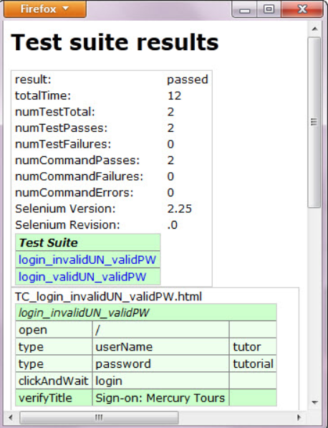
Inbuilt Test Generator of RC

Slide 11
Thanks

